Slide 1
CM1605 Web Technology
Web Integration with Data Sources (XML)
Week 9| Janani Harischandra

Slide 2
Learning Outcomes
Covers LO2 & LO4 for Module
On completion of this lecture, students are expected to be able to:
Understand the concept of XML, XML Elements, Rules, Element Naming, XML Parser and XML DOM
Apply knowledge of the XML DOM model to access and manipulate data stored in XML documents

Slide 3
Content
Introduction to XML
XML vs HTML
XML syntax rules
XML Elements
XML Element Naming & attributes
Display XML documents
XML Validator
XML DOM
Accessing XML Data and manipulation

Slide 4
Why study XML
Huge Demands for data exchange
XML stores data in plain text format.
This provides a software- and hardware-independent way of storing, transporting, and sharing data.
XML also makes it easier to expand or upgrade to new operating systems, new applications, or new browsers, without losing data.
With XML, data can be available to all kinds of "reading machines" like people, computers, voice machines, news feeds, etc.

Slide 5
Introduction to XML
XML stands for eXtensible Markup Language
XML is a markup language much like HTML
XML was designed to store and transport data
XML was designed to be self-descriptive
XML is a W3C Recommendation
XML is a software- and hardware-independent tool for storing and transporting data.

Slide 6
XML Vs HTML
XML | HTML
XML was designed to carry data - with focus on what data is | HTML was designed to display data - with focus on how data looks, (E.g., "Display this data as a heading " - <h3>...</h3>).
XML tags are not predefined, with XML you can define your own tags. | HTML tags are predefined, Eg: <html><h1><p>
XML separates data from presentation | HTML is used to format and display the same data

Slide 7
XML is Extensible
The XML document can be extended to carry more information. E.g., add more elements or define new tags as required.
The tags in the example above (like <from> and <to>) are not defined in any XML standard, It is invented by us.

Slide 8
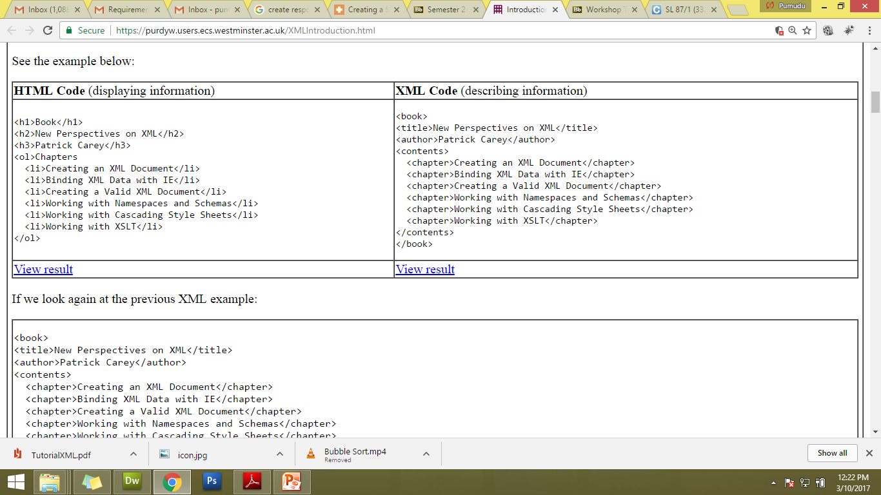
XML Vs HTML document

Slide 9
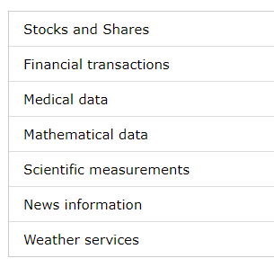
How can XML be used?
XML is used in many aspects of web development.
Thousands of XML formats exist, in many different industries, to describe day-to-day data transactions:

Slide 10
XML document
<?xml version="1.0" encoding="UTF-8"?> <bookstore> <book category="cooking"> <title lang="en">Everyday Italian</title> <author>Giada De Laurentiis</author> <year>2005</year> <price>30.00</price> </book> <book category="children"> <title lang="en">Harry Potter</title> <author>J K. Rowling</author> <year>2005</year> <price>29.99</price> </book> </bookstore>

Slide 11
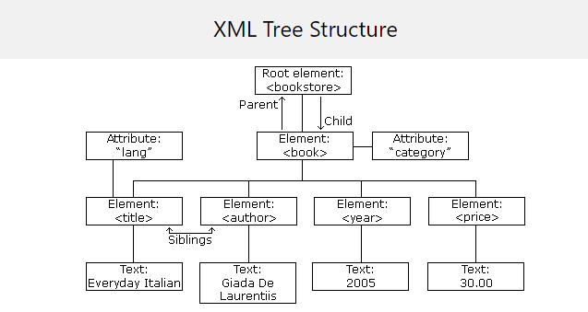
XML Tree
XML documents are formed as element trees.
An XML tree starts at a root element and branches from the root to child elements.
All elements can have sub elements (child elements):

Slide 12
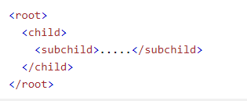
XML Tree Structure
The terms parent, child, and sibling are used to describe the relationships between elements.
Parents have children. Children have parents. Siblings are children on the same level (brothers and sisters).
All elements can have text content (Harry Potter) and attributes (category="cooking").

Slide 13
XML Syntax Rules
Rule No | Description
Rule 1 | XML documents must contain one root element that is the parent of all other elements
Rule 2 | All elements must have a closing tag
Rule 3 | XML tags are case sensitive. The tag <Letter> is different from the tag <letter>. Opening and closing tags must be written with the same case
Rule 4 | In XML, all elements must be properly nested within each other , eg: <b><i>This text is bold and italic</i></b>
Rule 5 | XML elements can have attributes in name/value pairs just like in HTML and the attribute values must always be quoted
Rule 6 | The syntax for writing comments in XML is similar to that of HTML <!-- This is a comment -->
Rule 7 | Some characters have a special meaning in XML, Refer to 5 pre-defined entity references in XML

Slide 14
Identify XML syntax rules??
<?xml version="1.0" encoding="UTF-8"?>
<book>
<title>New Perspectives on XML</title>
<author>Patrick Carey</author>
<contents>
<chapter>Creating an XML Document</chapter>
<chapter>Binding XML Data with IE</chapter>
<chapter>Creating a Valid XML Document</chapter>
<chapter>Working with Namespaces and Schemas</chapter>
<chapter>Working with Cascading Style Sheets</chapter>
<chapter>Working with XSLT</chapter>
</contents>
</book>
Well Formed XML
XML documents that conform to the syntax rules above are said to be "Well Formed" XML documents.

Slide 15
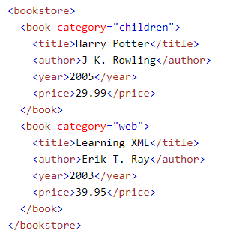
XML Elements
An XML element is everything from (including) the element's start tag to (including) the element's end tag.
An element can contain:
text
attributes
other elements
or a mix of the above
An element with no content is said to be empty.
In XML, an empty element is defined as
<element></element>
<element />

Slide 16
XML Naming Rules
XML elements must follow these naming rules:
Element names are case-sensitive
Element names must start with a letter or underscore
Element names cannot start with the letters xml (or XML, or Xml, etc)
Element names can contain letters, digits, hyphens, underscores, and periods
Element names cannot contain spaces
Any name can be used, no words are reserved (except xml).

Slide 17
XML Attributes
Attributes are designed to contain data related to a specific element.
Attribute values must always be quoted. Either single or double quotes can be used.
For a person's gender, the <person> element can be written like this:
<person gender="female">
<person gender='female'>

Slide 18
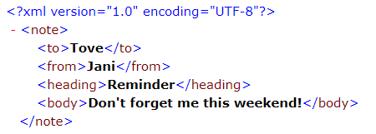
Display XML
Raw XML files can be viewed in all major browsers.
Don't expect XML files to be displayed as HTML pages.
Most browsers will display an XML document with color-coded elements.
Often a plus (+) or minus sign (-) to the left of the elements can be clicked to expand or collapse the element structure.
To view raw XML source, try to select "View Page Source" or "View Source" from the browser menu.

Slide 19
Viewing XML files with CSS
With CSS (Cascading Style Sheets) you can add display information to an XML document.
Below is an example of how to use a CSS style sheet to format an XML document:
<?xml version="1.0" encoding="UTF-8"?>
<?xml-stylesheet type="text/css" href="book.css"?>
<title>New Perspectives on XML</title>
<author>Patrick Carey</author>
<contents>
<chapter>Creating an XML Document</chapter>
<chapter>Binding XML Data with IE</chapter>
<chapter>Creating a Valid XML Document</chapter>
<chapter>Working with Namespaces and Schemas</chapter>
<chapter>Working with Cascading Style Sheets</chapter>
<chapter>Working with XSLT</chapter>
</contents>

Slide 20
XML Validator
Use XML validator to syntax-check your XML.
Errors in XML documents will stop your XML applications.
The W3C XML specification states that a program should stop processing an XML document if it finds an error. The reason is that XML software should be small, fast, and compatible.
HTML browsers are allowed to display HTML documents with errors (like missing end tags).
With XML, errors are not allowed.
Validators
https://www.xmlvalidation.com/
https://www.w3schools.com/xml/xml_validator.asp

Slide 21
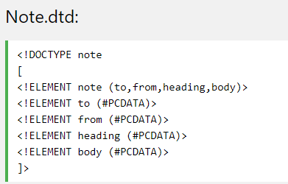
Valid XML
An XML document with correct syntax is called "Well Formed".
An XML document validated against a DTD is both "Well Formed" and "Valid".
DTD stands for Document Type Definition.
A DTD defines the structure and the legal elements and attributes of an XML document.
Read more on XML DTD -> https://www.w3schools.com/xml/xml_dtd.asp
Sample DTD file

Slide 22
XML Parser
All major browsers have a built-in XML parser to access and manipulate XML.
The XML DOM (Document Object Model) defines the properties and methods for accessing and editing XML.
However, before an XML document can be accessed, it must be loaded into an XML DOM object.
All modern browsers have a built-in XML parser that can convert text into an XML DOM object.

Slide 23
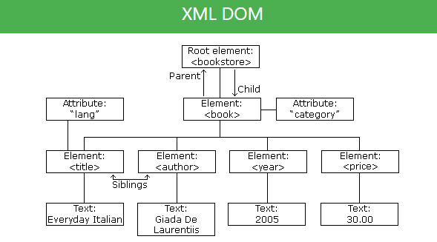
XML DOM
The XML DOM defines a standard way for accessing and manipulating XML documents. It presents an XML document as a tree-structure.
All XML elements can be accessed through the XML DOM.
It is a platform and language-neutral interface that allows programs and scripts to dynamically access and update the content, structure, and style of a document."

Slide 24
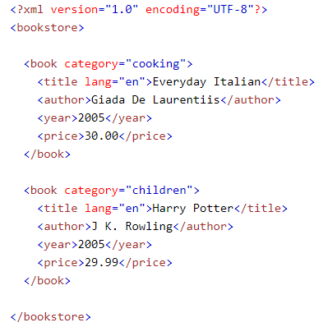
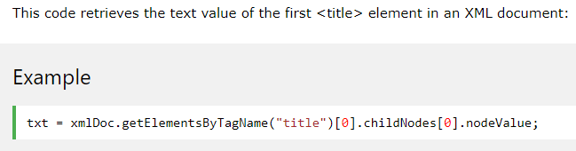
Accessing XML Nodes

Slide 25
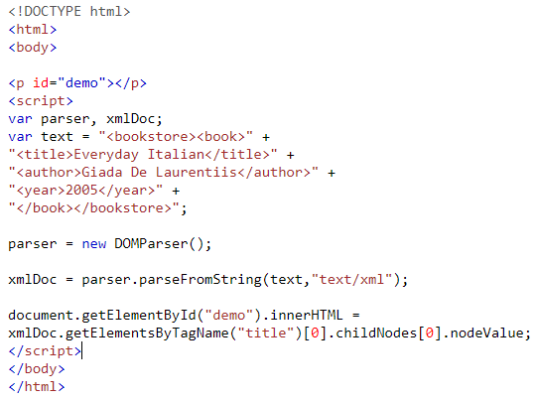
XML Parser Example
This example parses a text string into an XML DOM object, and extracts the info from it with JavaScript.
A text String is defined
An XML DOM Parser is created
The parser creates a new XML DOM object using the text string

Slide 26
Reading
Online :
https://www.w3schools.com/xml/default.asp

